Slide 1
Design and Analysis of Algorithms
Lectures Week 7 & 8

Slide 2
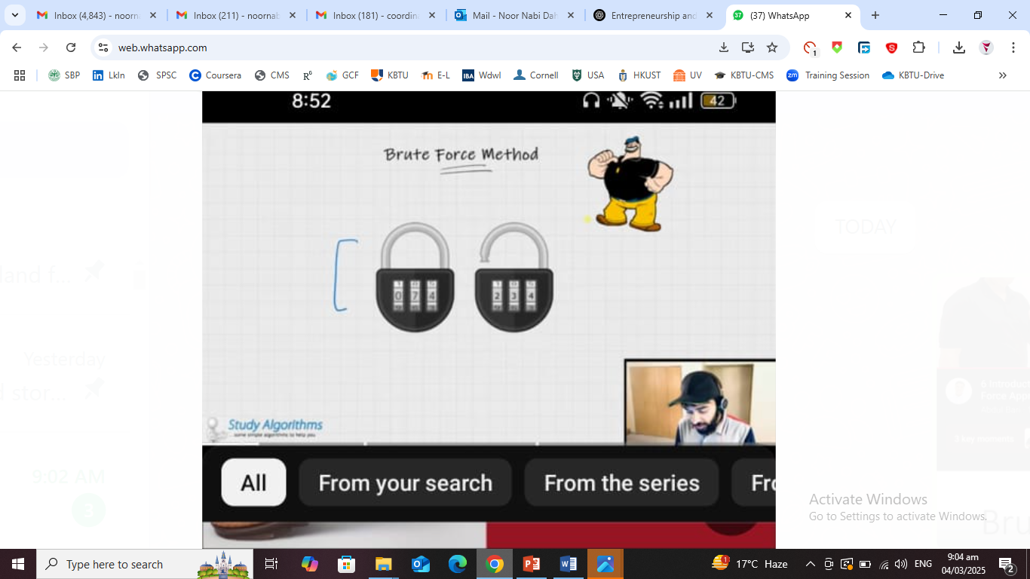
Brute Force Algorithms
Definition: A brute force algorithm tries all possible solutions until it finds the correct one.
Problem Concept: It is slow because it checks every option, even when a better method exists.
Example: Trying every possible password in a password hack attempt. If the password is "1234", the algorithm checks "0000", "0001", "0002", ..., until "1234" is found.

Slide 3


Slide 4
Exhaustive Search
✅ Definition: A method that tries all possible solutions to find the best one. 🚨 Problem Concept: It is very slow because it checks every option without shortcuts. 🔹 Example: Finding all ways to arrange books on a shelf and choosing the best arrangement.
Travelling Salesman Problem (TSP)
Definition: A problem where a salesperson must visit multiple cities and return to the starting point using the shortest possible route.
Problem Concept: Checking every possible route takes too much time as the number of cities increases. Example: A delivery driver finding the shortest route to deliver packages to many locations and return home.

Slide 5
Tricky Travelling Salesman Problem (TSP) - Class Activity
💡 Problem Statement:
A delivery person named Alex works for QuickExpress Delivery. Alex must deliver packages to five different cities:
1️⃣ City A (10 km from the start) 2️⃣ City B (15 km from City A, 20 km from the start) 3️⃣ City C (30 km from City B, 25 km from City A) 4️⃣ City D (5 km from City B, 10 km from City C, 40 km from the start) 5️⃣ City E (20 km from City A, 25 km from City C, 35 km from City D, 50 km from the start)
Alex must start and end at the warehouse while visiting each city exactly once.
Challenge for Students:
Find the shortest route for Alex to take.
Calculate the total distance traveled for that route.
Suggest a real-world strategy (e.g., using a map or software) to optimize the route.
If a road between two cities is closed, how would you adjust the route?
🎯 Goal: Find the most efficient way to minimize Alex’s total travel distance! 🚛💨
Let me know if you want modifications! 😊

Slide 6
Knapsack Problem
Definition: A problem where you have a bag (knapsack) with a weight limit, and you must pick items with the highest total value without exceeding the weight limit.
Problem Concept: Choosing the best combination of items requires checking many possibilities.
Example: Packing a suitcase with limited space, choosing the most important clothes and items while avoiding overpacking.

Slide 7
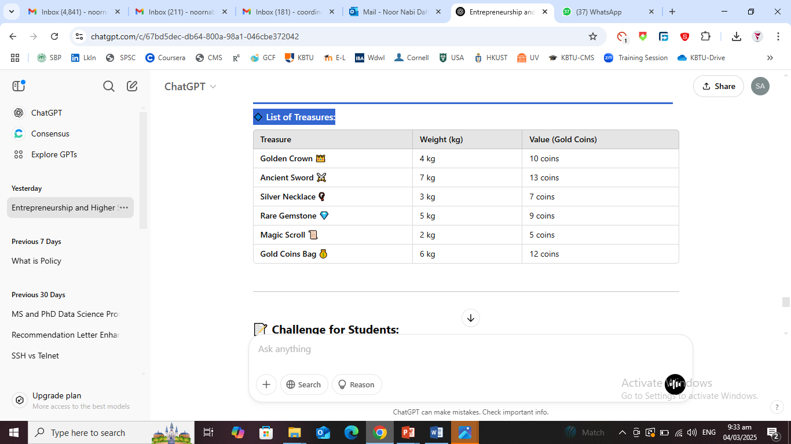
Tricky Knapsack Problem – Class Activity Puzzle
💡 Problem Statement:
You are a treasure hunter exploring the ancient Vault of Azkar! 🏆 Inside the vault, you discover a magical bag (knapsack) that can carry a maximum weight of 15 kg. The vault contains six valuable treasures, but you can only take what fits in the bag. Each item has a weight and a value in gold coins.
🔹 List of Treasures:
Challenge for Students:
Pick the best combination of treasures that maximizes the total value without exceeding 15 kg. Calculate the total weight and value of your selected items. if a mystical force increases the bag's limit to 18 kg, how would your selection change? if the Rare Gemstone's value doubles, does it affect your decision? 🎯 Goal: Choose wisely and maximize your treasure! 🏆✨

Slide 8
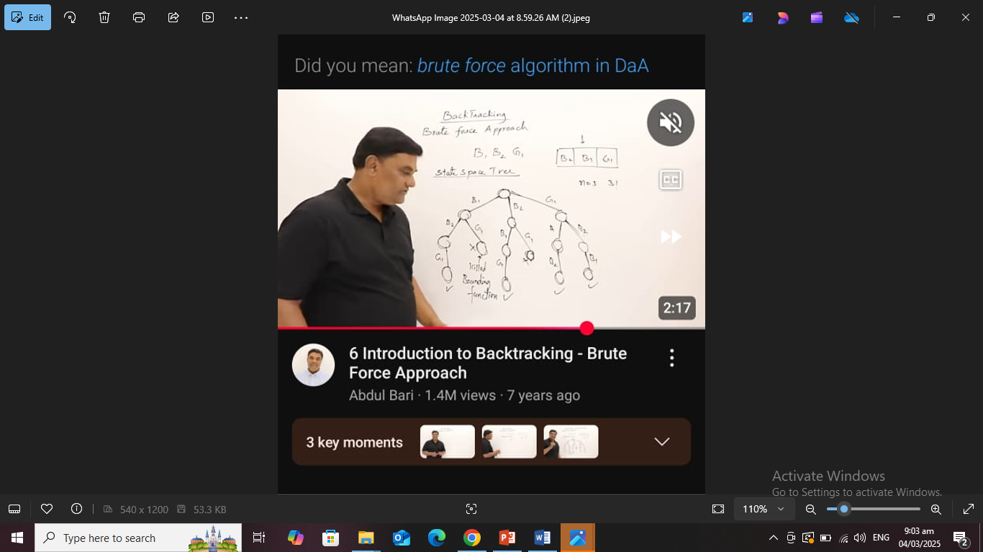
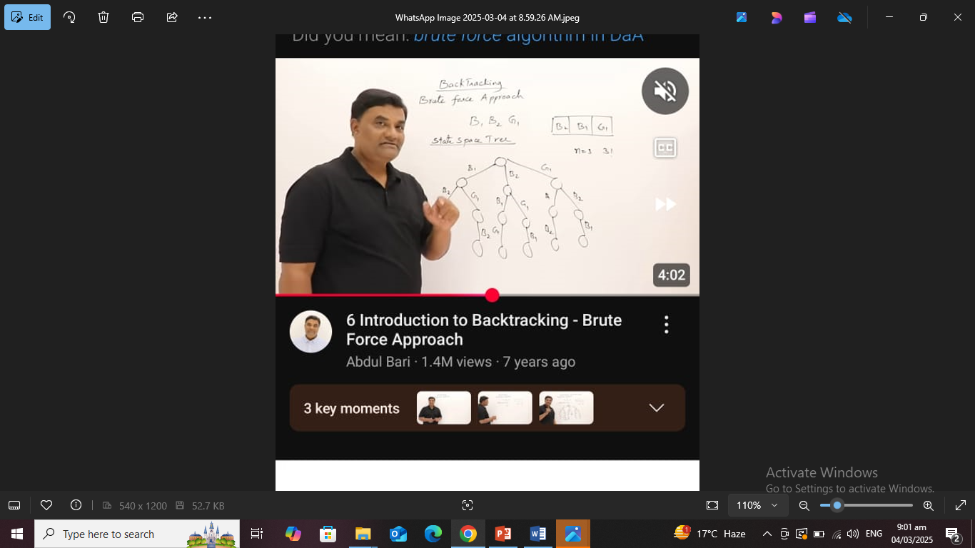

Slide 9
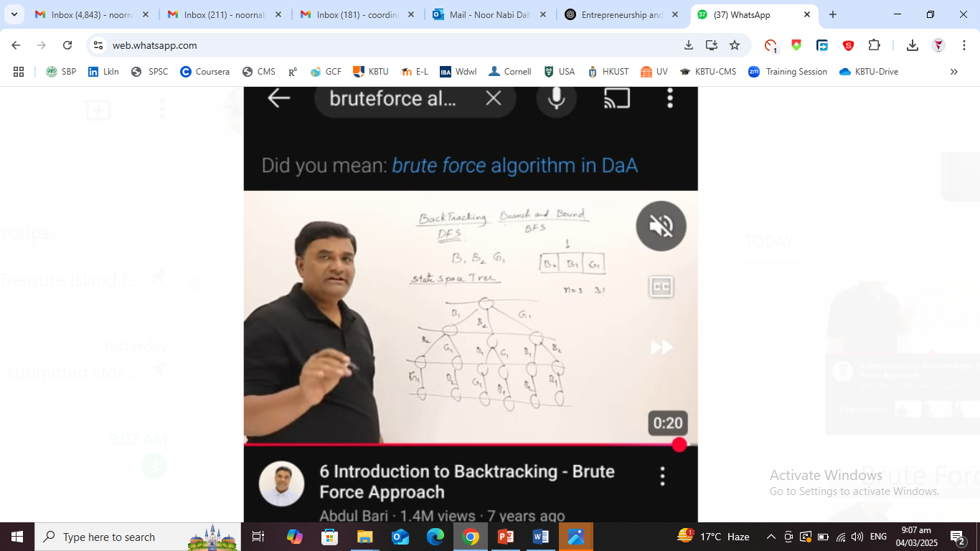
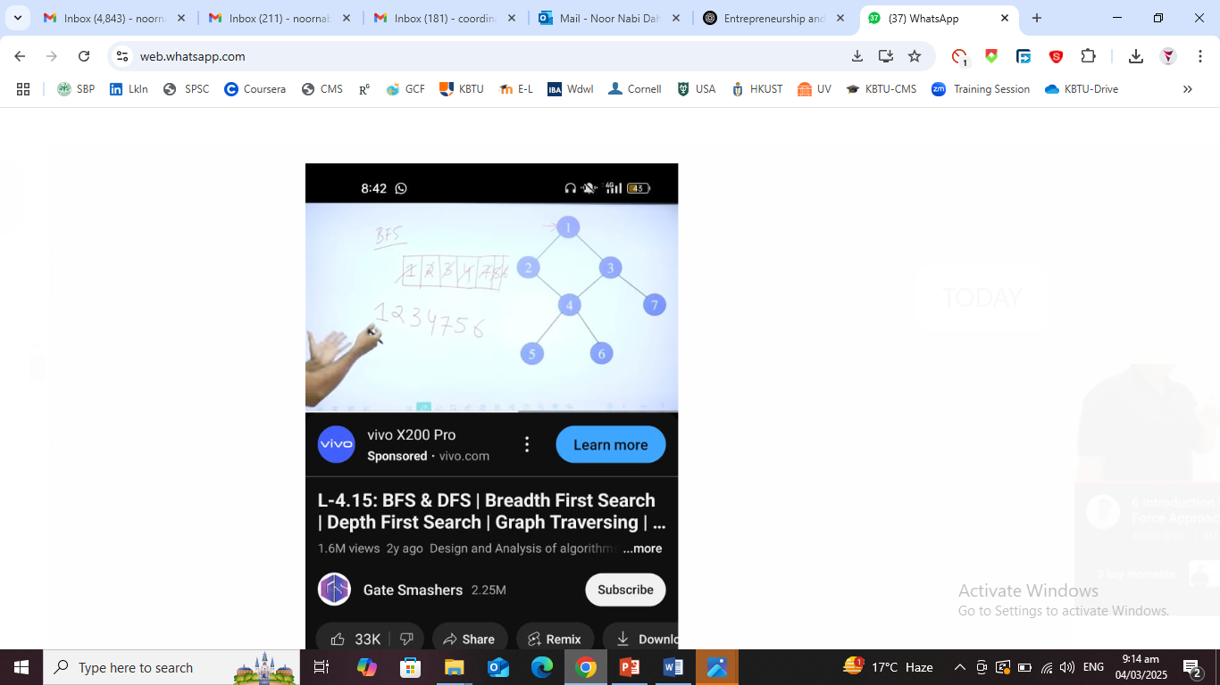
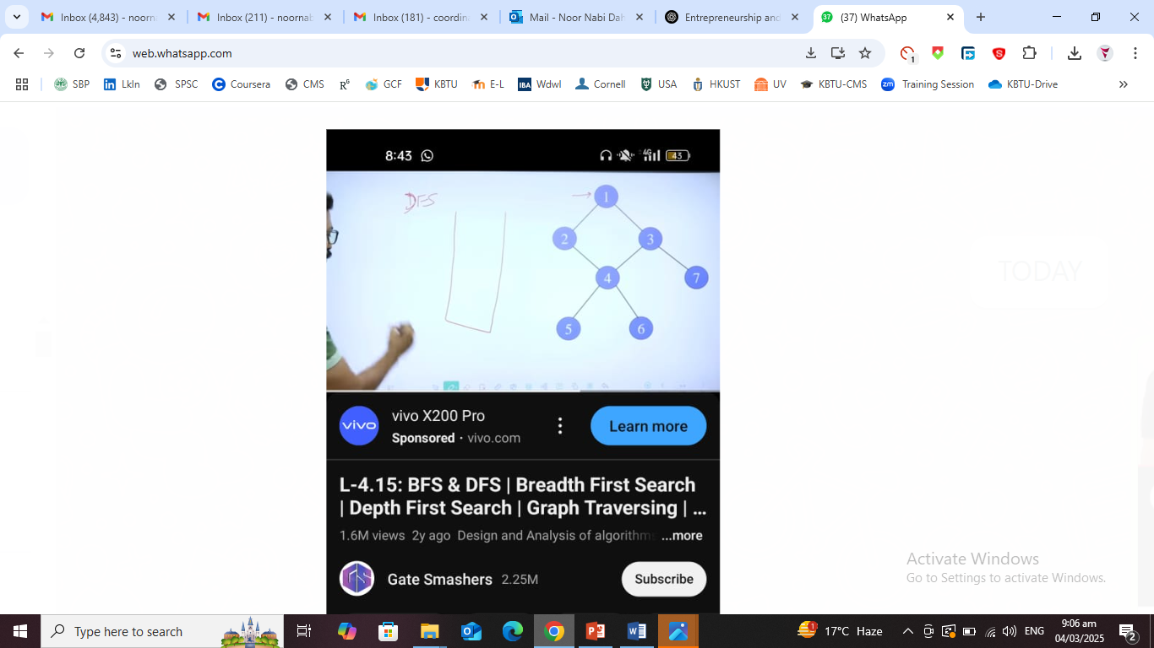

Slide 10
The Lost Key Encryption Challenge (Information Security - Cryptography)
💡 Problem Statement: A secret agent Alex needs to decrypt a classified message but the decryption key is missing! The key is a 4-digit number where:
1 The first digit is the sum of the last two digits. 2 The second digit is double the third digit. 3 The third digit is half of the last digit. 4The sum of all digits is 14.
🎯 Your Challenge:
Find the 4-digit decryption key using logical reasoning.
👉 Hint: Use algebra to find the digits step-by-step.

Slide 11
Types of Decrease and Conquer Algorithms
Decrease by One → Solve by reducing the problem by one in each step.
2. Decrease by a Constant Factor → Reduce the problem size by a fixed fraction in each step.
3. Variable-Size Decrease → Reduce the problem size by varying amounts.
Why we use?
The Decrease and Conquer technique is used because it simplifies complex problems by breaking them down into smaller, manageable parts. This makes solving problems faster, more efficient, and easier to implement.

Slide 12
Key Reasons to Use Decrease and Conquer Algorithms
Improves Efficiency
Reducing the problem size in each step makes algorithms faster compared to brute force methods.
Example: Binary Search (O(log n)) is much faster than Linear Search (O(n)).
Simplicity in Problem Solving
Easier to break down and solve step by step instead of handling everything at once.
Example: Insertion Sort builds a sorted list one element at a time, making it easy to understand.

Slide 13
Con..
Uses Less Memory (Space-Efficient)
Many Decrease and Conquer algorithms use less extra memory than Divide and Conquer.
Example: Insertion Sort sorts in-place using O(1) extra space, while Merge Sort needs O(n) extra space.
Summary: ✅ Best for problems that reduce naturally in steps ✅ More efficient than brute force ✅ Uses less memory than Divide and Conquer ❌ Not always the most optimal approach ❌ May still be inefficient for large datasets

Slide 14
Examples of Decrease and Conquer Algorithms
📌 Insertion Sort (Decrease by One)
✅ Definition:
In Insertion Sort, the array is sorted one element at a time by placing it in the correct position.
Each step reduces the unsorted portion by one element, making it a "Decrease by One" algorithm.
✅ Example: Unsorted Array: [5, 3, 8, 2] 1️ Start with [5] (already sorted). 2️ Insert 3 → [3, 5] 3️ Insert 8 → [3, 5, 8] 4 Insert 2 → [2, 3, 5, 8] (Sorted ✅)
📌 Time Complexity:
Best Case: O(n) (Already sorted)
Worst Case: O(n^2) (Reverse sorted)

Slide 15
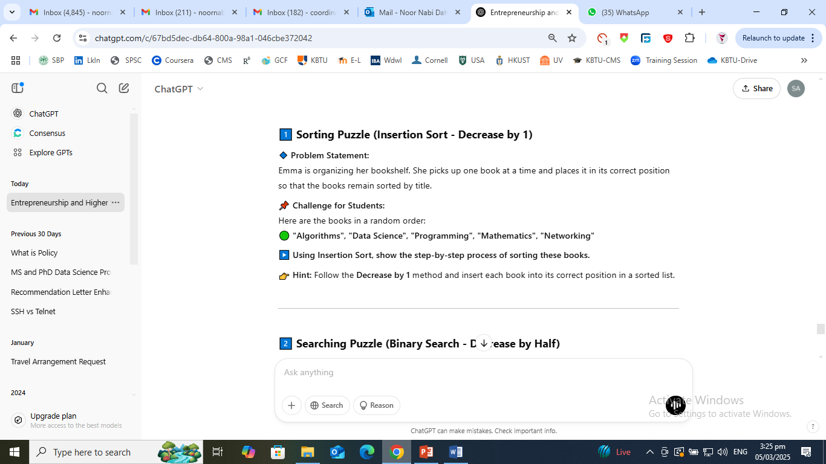

Slide 16
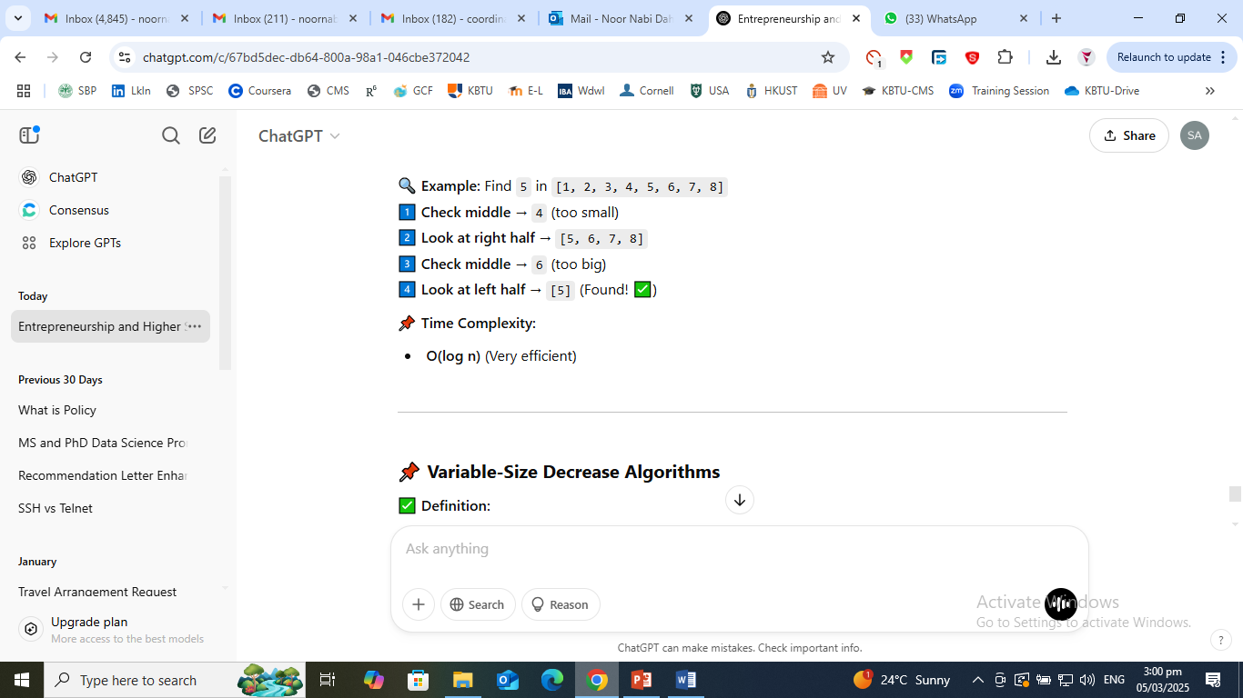
Decrease by a Constant Factor Algorithm
✅ Definition:
The problem size is reduced by a constant fraction (e.g., half) in each step.
This is faster than Decrease by One.
✅ Example: Binary Search (Divides Problem by 2 in Each Step)
Given a sorted list, Binary Search finds an element by checking the middle and eliminating half each time.

Slide 17
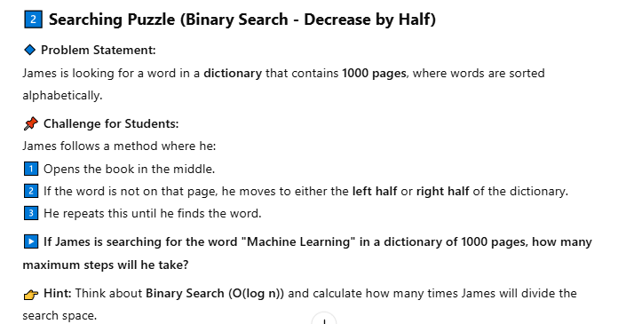

Slide 18
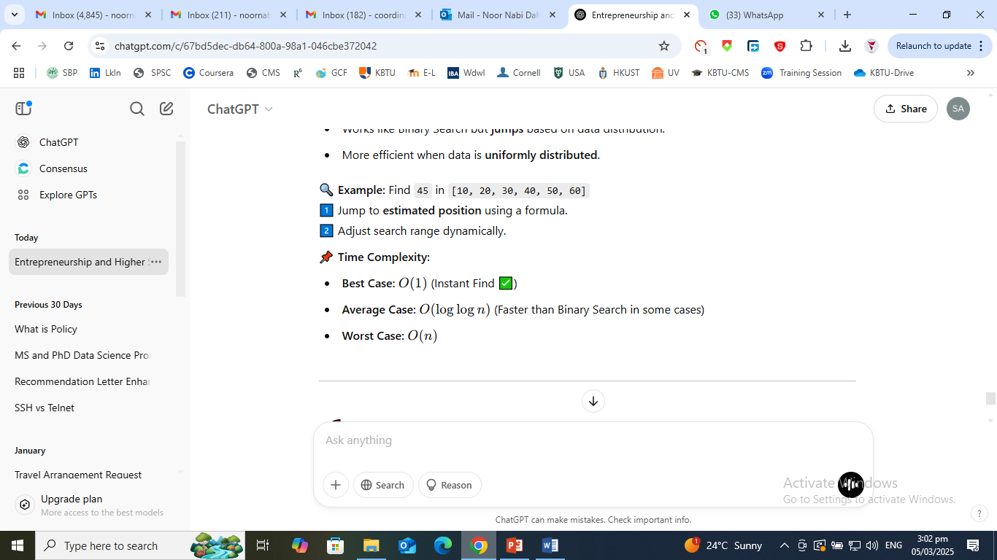
Variable-Size Decrease Algorithms
✅ Definition:
The problem is reduced by different amounts in each step (not a fixed number or fraction).
✅ Example: Interpolation Search
Works like Binary Search but jumps based on data distribution.
More efficient when data is uniformly distributed.

Slide 19
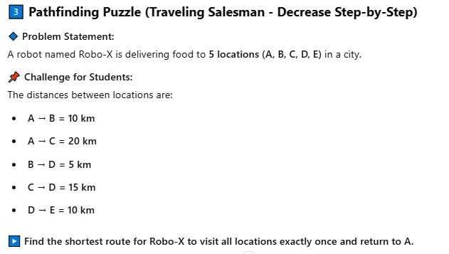

Slide 20
Mathematical Modeling & Simple Pseudocode for Decrease and Conquer
📌 Mathematical Model
The general form of a Decrease and Conquer algorithm can be expressed as:
T(n)=T(n−k)+f(n)
Where:
n = problem size
k = the amount by which the problem size is reduced
f(n)= the additional work done at each step
For example:
Insertion Sort: T(n)=T(n−1)+O(n)
Binary Search: T(n)=T(n/2)+O(1)

Slide 21
INSERTION_SORT(A, n):
if n ≤ 1:
return # Base case (1 element is already sorted)
INSERTION_SORT(A, n-1) # Sort first n-1 elements
key = A[n] # Take the nth element
j = n - 1
while j >= 0 and A[j] > key:
A[j+1] = A[j] # Shift elements
j = j - 1
A[j+1] = key # Place key in the right position
BINARY_SEARCH(A, left, right, target):
if left > right:
return -1 # Element not found
mid = (left + right) / 2 # Find middle element
if A[mid] == target:
return mid # Found!
if A[mid] > target:
return BINARY_SEARCH(A, left, mid - 1, target) # Search left half
else:
return BINARY_SEARCH(A, mid + 1, right, target) # Search right half

Slide 22
Aspect | Advantages | Disadvantages
Efficiency | Faster than brute-force methods (e.g., Binary Search is O(log n) vs. Linear Search O(n)) | Some algorithms (e.g., Insertion Sort) are still slow for large datasets (O(n²) in worst cases)
Memory Usage | Uses less extra memory than Divide and Conquer (e.g., Insertion Sort uses O(1) space) | Some problems require extra memory for recursion (e.g., recursive Binary Search)
Simplicity | Easier to understand and implement than Divide and Conquer algorithms | Not always the most optimal approach (e.g., Merge Sort is better than Insertion Sort for large arrays)
Problem Suitability | Works well for problems that naturally reduce step by step (e.g., Binary Search, Topological Sorting) | Some problems require global processing instead of step-by-step reduction
Real-World Applications | Used in searching (Binary Search), sorting (Insertion Sort), and graph processing (DFS, Topological Sorting) | May not be suitable for highly complex problems like dynamic programming or advanced optimization tasks

Slide 23
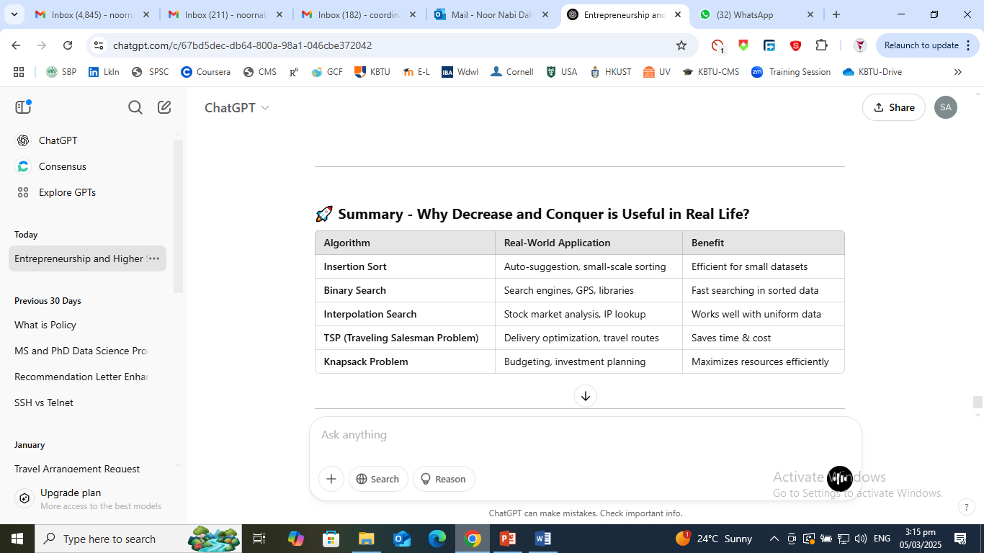

Slide 24
Divide and Conquer
🔹 Definition: Divide and Conquer is a problem-solving technique that breaks a problem into smaller sub problems, solves each sub problem, and then combines the results to get the final answer.
🔹 Steps in Divide and Conquer: Divide → Break the problem into smaller sub problems. Conquer → Solve each sub problem recursively. Combine → Merge the solutions of the sub problems to get the final result.

Slide 25
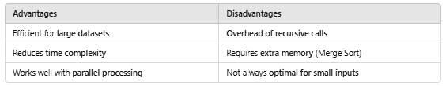
Real-Life Example:
Imagine you have a large book with 1000 pages that needs sorting. Instead of sorting all pages at once, you:
Divide the book into small sections (e.g., 100 pages each).
Sort each section separately.
Combine the sections into one sorted book.

Slide 26
Why Use Divide and Conquer?
✅ Efficient for large problems – Works faster than simple iterative methods.
✅ Breaks complex problems into simpler ones – Easier to handle.
✅ Reduces time complexity – Faster than brute force approaches.
✅ Used in various algorithms – Sorting, searching, and mathematical computations.

Slide 27
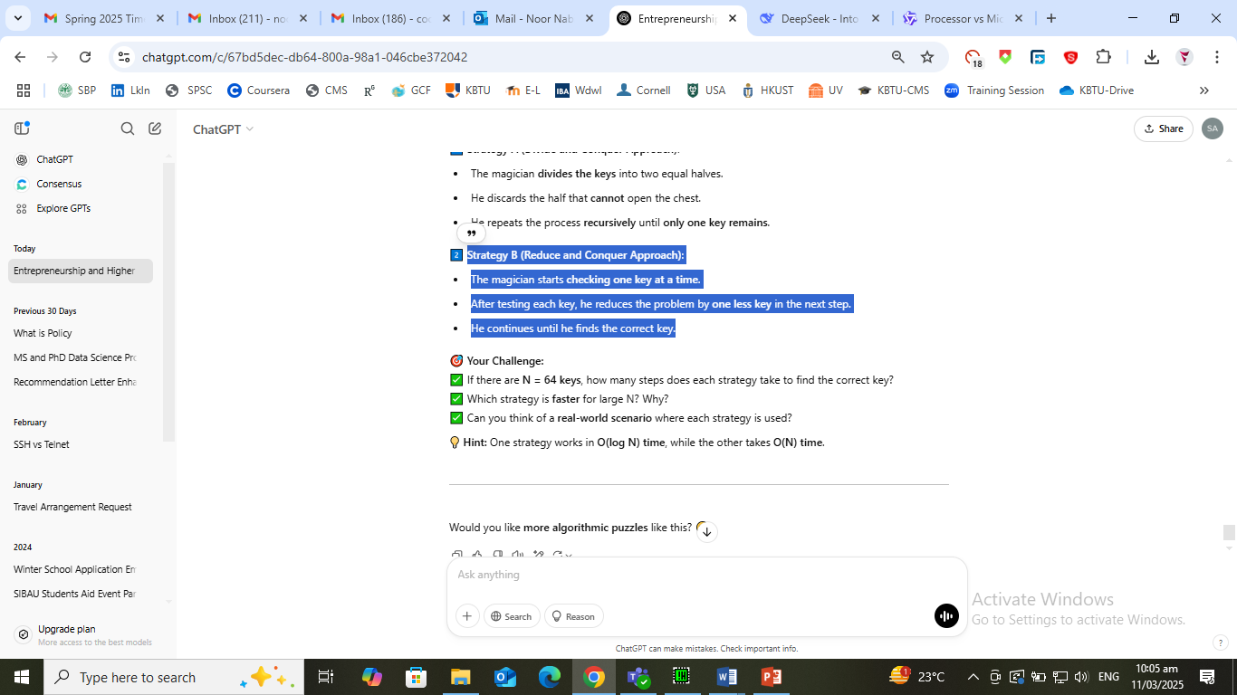
📌 Think and Answer.
Problem Statement: A magician has a magical box filled with N identical-looking keys, but only one of them opens the golden treasure chest. The magician follows two different strategies:
1. Strategy A (Divide and Conquer Approach):
The magician divides the keys into two equal halves.
He discards the half that cannot open the chest.
He repeats the process recursively until only one key remains.
2. Strategy B (Reduce and Conquer Approach):
The magician starts checking one key at a time.
After testing each key, he reduces the problem by one less key in the next step.
He continues until he finds the correct key.

Slide 28
Merge Sort (Divide and Conquer Sorting Algorithm)
🔹 Explanation:
Merge Sort is a stable sorting algorithm that uses Divide and Conquer to sort elements efficiently.
🔹 How It Works?
Divide: Split the list into two equal halves. Conquer: Recursively sort each half. Combine: Merge the sorted halves into a single sorted list.
🔹 Example: Sorting [7, 2, 5, 1, 9]

Slide 29
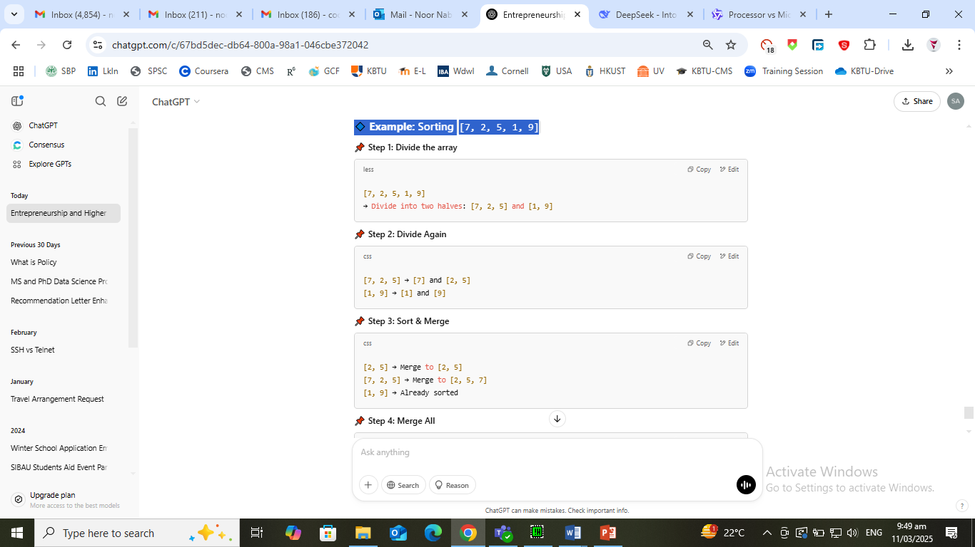
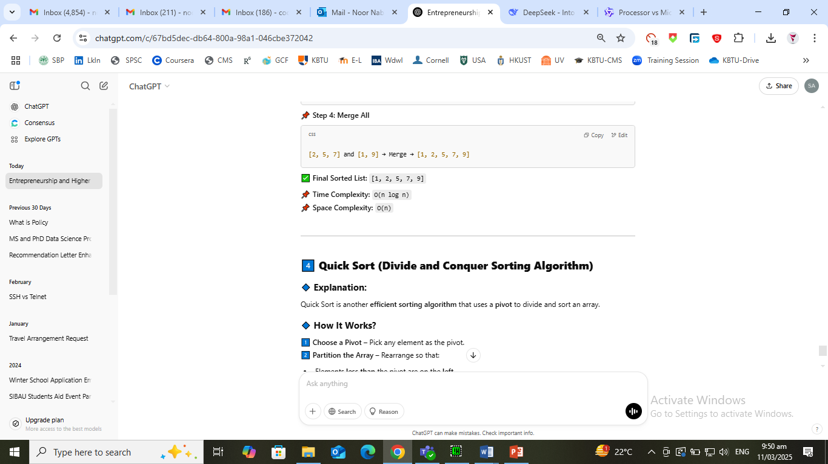

Slide 30
Quick Sort (Divide and Conquer Sorting Algorithm)
🔹 Explanation:
Quick Sort is another efficient sorting algorithm that uses a pivot to divide and sort an array.
🔹 How It Works?
Choose a Pivot – Pick any element as the pivot. Partition the Array – Rearrange so that:
Elements less than the pivot are on the left.
Elements greater than the pivot are on the right.
Recursively Apply QuickSort – Repeat the process for the left and right partitions.
🔹 Example: Sorting [8, 3, 7, 6, 1, 5]

Slide 31
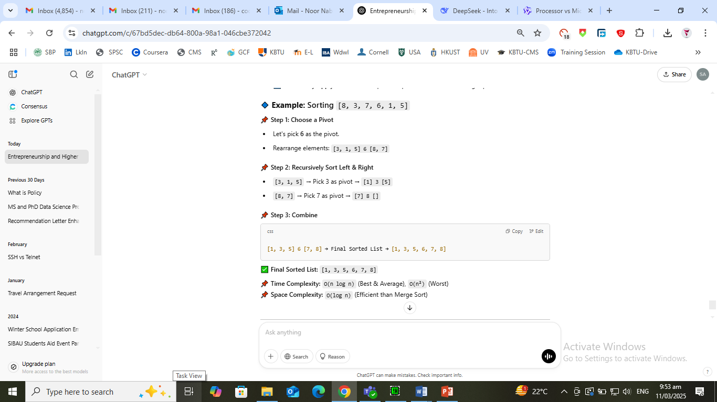

Slide 32
Matrix Multiplication Using Divide and Conquer
🔹 Explanation:
Instead of multiplying matrices traditionally (O(n³) complexity), Divide and Conquer splits the matrices into smaller submatrices
for faster computation.
🔹 Steps:
Divide: Split n × n matrix into 4 equal n/2 × n/2 matrices. Conquer: Compute smaller matrix multiplications recursively. Combine: Use mathematical formulas to merge results.

Slide 33
